Slide 1

Predicting customer booking behaviour
using a Random Forest model
SUMMARY

Slide 2
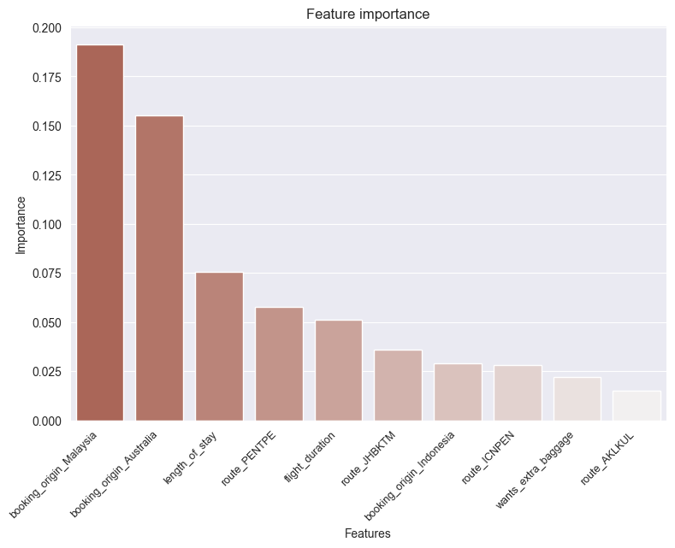
A trained Random Forest model produced the following results:
Accuracy: 87.02 (after hyperparameter tuning)
AUC score: 0.75 (fair measurement of separability, but can be improved)
Top 5 features that influence a customer behaviour are:
Booking origin
Length of stay
Route
Flight duration
If a customer wants extra baggage

